Slide 1
SHIFT AND ROTATE
Course Code: 0052
Course Title: Computer Organization and Architecture
Dept. of Computer Science
Faculty of Science and Technology
Lecturer No: | 7(b) | Week No: | 10 | Semester: | Spring 21-22
Lecturer: | Dr. Md Mehedi Hasan; mmhasan@aiub.edu

Slide 2

Overview: ROTATE
Rotates work like the shifts, except that when a bit Is shifted out one end of an operand it is put back in the other end.
These instructions can be used to examine and/or change bits or groups of bits.
*** Logic, shift, and rotate instructions is used to do binary and hexadecimal I/O.
The ability to read and write numbers will let us solve a great variety of problem.

Slide 3
Example SHR
Problem: Suppose DH contains 8Ah and CL contains 2. What are the values of DH and CF after the Instruction SHR DH,CL is executed?
Solution: The value of DH in binary is 1000 1010.
After two right shifts, CF=1
The new value of DH is obtained by erasing the rightmost two bits and adding two 0 bits to the left end, thus DH =0010 0010b = 22h.

Slide 4
Example SHR
Initial Values : DH = 8Ah (1000 1010 in binary), CL = 2 (This means the value in DH will be shifted right by 2 bits). SHR Instruction (Shift Logical Right):SHR (Shift Logical Right) shifts the bits of a register to the right.For each bit shift: The rightmost bit is shifted into the Carry Flag (CF).The leftmost bit is filled with 0. step-by-Step Execution:Initial DH Value in Binary:1000 1010
First Right Shift: New DH: 0100 0101 CF: The bit shifted out (0).
Second Right Shift:New DH: 0010 0010 CF: The bit shifted out (1).
Final Result:Final DH: 00100010 (in binary) = 22h (in hexadecimal).Final CF: 1 (because the last bit shifted out was 1).Final Answer:DH = 22h, CF = 1

Slide 5
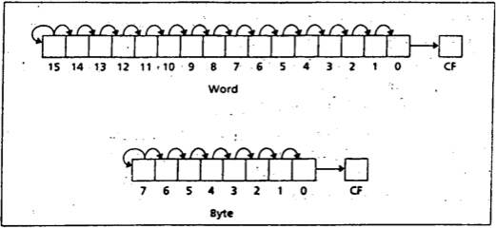
SAR Instruction
The SAR Instruction (shift arithmetic right) operates like SHR , with one difference: the msb retains Its original value. The syntax is:
SAR destination,1
SAR destination, CL

Slide 6
SAR Instruction
SAR (Shift Arithmetic Right) is an instruction used to shift the bits of a destination register to the right.Unlike SHR (Shift Logical Right), which always fills the leftmost bit with 0, SAR preserves the Most Significant Bit (MSB) (sign bit for signed numbers).This means SAR can be used for signed number division by powers of two, while maintaining the sign of the number. How SAR Works:The MSB (Most Significant Bit) remains unchanged.The other bits are shifted right, and the rightmost bit is shifted out into the Carry Flag (CF).

Slide 7
SAR Instruction
Example:Initial Value:Register DH = 8Ah (1000 1010 in binary) CL = 2 (number of shifts). Using SAR DH, CL
:MSB (1) is retained as it is a signed number.
First Shift: 1100 0101 (CF = 0).Second Shift: 1110 0010 (CF = 1).Final Result:DH = E2h, CF = 1.
Aspect | SHR (Logical Right) | SAR (Arithmetic Right)
MSB Handling | Filled with 0 | Retains its original value
Application | Unsigned numbers | Signed numbers
Effect on Sign Bit | Changes (becomes 0) | Remains unchanged

Slide 8
SAR Instruction
Aspect | Signed Numbers | Unsigned Numbers
Definition | Can represent both positive and negative values. | Can represent only positive values (including zero).
Range (8-bit) | -128 to +127 | 0 to 255
MSB (Most Significant Bit) | Acts as the sign bit (0 = positive, 1 = negative). | Part of the value (no sign bit).
Binary Representation | Two's Complement (for negative values). | Standard binary representation.
Example (8-bit) | 11111111 = -1, 01111111 = +127 | 11111111 = 255, 00000001 = 1
Use Case | Values that can be negative (e.g., temperature, debt). | Values that are always positive (e.g., age, quantity).

Slide 9
Division by Right Shift
A Left shift doubles the destination's value,
Similarly, it’s reasonable to guess that a right shift might divide it by 2. This Is correct for even numbers.
For odd numbers, a right shift halves it and rounds down to the nearest integer.
For example, if BL contains 00000101 = 5, then after a right shift. BL will contain 00000010 = 2

Slide 10
Signed and Unsigned Division
In case of division by right shifts, we need to make a distinction between signed and unsigned numbers.
If an unsigned interpretation is being given, SHR should be used.
For a signed interpretation, SAR must be used, because it preserves the sign.
Problem: Use right shifts to divide the unsigned number 65143 by 4. Put the quotient in AX
To divide by 4, two right shifts are needed. Since the dividend is unsigned, we use SHR. The code is
Each right shift divides the number by 2.So, 2 right shifts (SHR) effectively divide the number by 4 (2^2).
MOV AX, 65143
MOV CL, 2
SHR AX,2

Slide 11
Signed and Unsigned Division
MOV AX, 65143 ; Load the value 65143 (which is FEA7h in hex) into AX.
MOV CL, 2 ; Load the value 2 into CL (number of right shifts).
SHR AX, CL ; Perform logical right shift on AX by 2 bits.
Binary Representation:Decimal (65143) = Hexadecimal (FEA7h).Binary: 1111 1110 1010 0111.
First Right Shift:Before: 1111 1110 1010 0111 After: 0111 1111 0101 0011
CF (Carry Flag): 1 (the last bit shifted out).
Second Right Shift:Before: 0111 1111 0101 0011 After: 0011 1111 1010 1001 CF: 1 (the last bit shifted out).
Final Result:AX = 0011 1111 1010 1001 (16385 in decimal).The quotient of 65143 ÷ 4 = 16385.

Slide 12
SAR
Example: If AL contains -15, give the decimal value of AL after SAR AL,1 is performed.
Solution: Execution of SAR AL,1 divides the number by 2 and rounds down.
Dividing -15 by 2 yields -7.5, and after rounding down we get -8.
In terms of the binary contents, we have -15=11110001b. After shifting, we have 11111000b= -8.
*** We will see some MUL and DIV for multiplication operations that are not limited to power of 2 only. However, MUL and DIV is much slower than SHIFT operation

Slide 13
SAR
Initial Value:
AL = -15 (signed 8-bit number).
We are using SAR (Shift Arithmetic Right), which:
Divides the number by 2 (each right shift is division by 2).
Retains the Most Significant Bit (MSB) (sign bit) for signed numbers.
Rounds down (toward negative) for negative numbers.
Binary Representation of -15:Since this is a signed 8-bit number, we use two's complement for negative values.+15 in Binary: 0000 1111Two's Complement of +15 (to get -15):Invert all bits: 1111 0000Add 1: 1111 0001So, -15 = 1111 0001 (in binary).

Slide 14
SAR
Performing SAR AL, 1 (Shift Arithmetic Right):
Before Shift:
1111 0001 (-15 in binary)
After SAR AL, 1:
The MSB (1) is kept because it is a signed number.
The other bits are shifted right by 1, and the MSB (1) is copied to the left.
1111 1000
This is because the MSB (sign bit) is 1 (negative), so it must be retained.

Slide 15
SAR
Converting the Result Back to Decimal:The binary value 1111 1000 is still a signed number.Since the MSB is 1, it is negative (two's complement form).To find the decimal value:Invert the bits: 0000 0111. Add 1: 0000 1000 (8 in decimal).Add a negative sign because of the MSB: -8.
Final Answer:
The final value of AL = -8

Slide 16
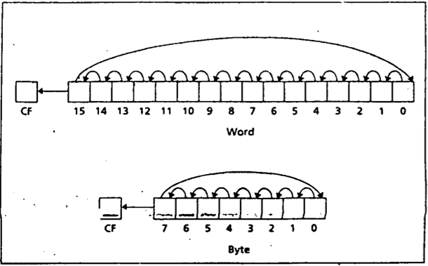
Rotate Instructions
The instruction ROL (rotate left) shifts bits to the left. The msb shifted into the rightmost bit.
The CF also gets the bit shifted out of the msb.
You can think of the destination bits forming a circle, with the least significant bit following the msb in the circle.
ROL destination, 1
and
ROL destination, CL

Slide 17
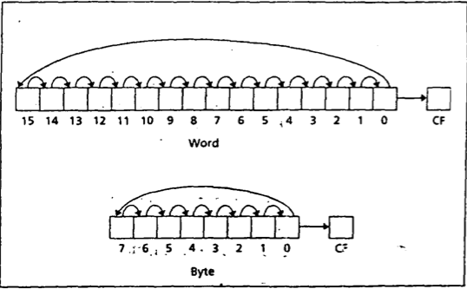
Rotate Right (ROR)
The instruction ROR (rotate right) works just like ROL except that the bits are rotated to the right.
The rightmost bit is shifted into the msb, and also into the CF
ROR destination, 1
and
ROR destination, CL

Slide 18
ROL, ROR and CF
In ROL and ROR, CF reflects the bit that is rotated out.
ROL and ROR can be used to inspect the bits in a byte or word, without changing the contents.
Example: Use ROL to count the number of 1 bits in BX, without changing BX. Put the answer in AX.
Solution:
XOR AX,AX
MOV CX,16
TOP:
ROL BX,1
JNC NEXT
INC AX
NEXT:
LOOP TOP

Slide 19
ROL, ROR and CF
IROL (Rotate Left):
Bits are shifted to the left.
The leftmost bit (MSB) is moved to the rightmost bit (LSB) and also to CF (Carry Flag).
ROR (Rotate Right):
Bits are shifted to the right.
The rightmost bit (LSB) is moved to the leftmost bit (MSB) and also to CF (Carry Flag).
2. Difference Between Shift and Rotate:
SHR or SHL: Bits shifted out are lost, and new bits are 0.
ROL or ROR: Bits shifted out are reinserted at the opposite end, preserving the value.

Slide 20
ROL, ROR and CF
3. CF (Carry Flag) in ROL and ROR:
In ROL, the MSB (leftmost bit) is moved to:
CF (Carry Flag).
LSB (rightmost bit).
In ROR, the LSB is moved to:
CF (Carry Flag).
MSB.

Slide 21
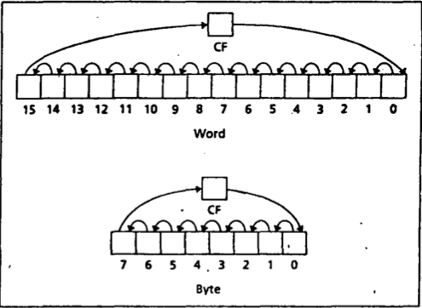
RCL (Rotate Carry Left)
The Instruction RCL (Rotate through Carry LEFT) shifts the bits of the destination to the left.
The msb is shifted Into the CF and the previous value of CF is shifted Into the rightmost bit.
In other words, RCL works like Just like ROL, except that CF is part of the circle of bits being rotated. The syntax is:
RCL destination,1
and
RCL destination, CL

Slide 22
RCR (Rotate Carry Right)
The Instruction RCR (Rotate through Carry RIGHT) works just like RCL except the bits are rotated to the right. The syntax is:
RCR destination,1
and
RCR destination, CL

Slide 23
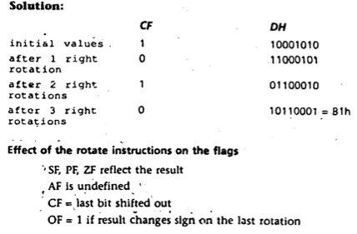
Example
Suppose DH contains 8Ah, CF= 1, and CL contains 3.
What are the values of DH and CF after the instruction RCR DH,CL is executed?

Slide 24
ROL, ROR and CF
Initial Values:
DH = 8Ah (1000 1010 in binary)
CF = 1 (Carry Flag is set).
CL = 3 (indicates that the rotation will be by 3 bits).
Instruction:
RCR DH, CL → Rotate through Carry Right.
This means the bits of DH are rotated to the right through CF (Carry Flag).
Since CL = 3, the bits will be rotated right by 3 positions.

Slide 25
ROL, ROR and CF
RCR (Rotate through Carry Right):The rightmost bit (LSB) is moved to CF (Carry Flag).The previous value of CF is moved to the leftmost bit (MSB).This process is repeated for the number of times specified in CL.Step-by-Step Execution:1.
Initial Binary Values:DH: 1000 1010
CF: 1

Slide 26
ROL, ROR and CF
RCR (Rotate through Carry Right):The rightmost bit (LSB) is moved to CF (Carry Flag).The previous value of CF is moved to the leftmost bit (MSB).This process is repeated for the number of times specified in CL.Step-by-Step Execution:1.
Initial Binary Values:DH: 1000 1010
CF: 1
First Rotation (RCR DH, 1):
Before:
CF = 1, 1000 1010
The rightmost bit (0) goes to CF.The current CF (1) becomes the leftmost bit of DH. After:
CF = 0, 1100 0101

Slide 27
ROL, ROR and CF
Second Rotation (RCR DH, 1):Before:
CF = 0, 1100 0101
The rightmost bit (1) goes to CF.The current CF (0) becomes the leftmost bit of DH.After:
CF = 1, 0110 0010
Third Rotation (RCR DH, 1):Before:
CF = 1, 0110 0010
The rightmost bit (0) goes to CF.The current CF (1) becomes the leftmost bit of DH.After:
CF = 0, 1011 0001
Final Result:DH = 1011 0001 (B1h), CF = 0
Final Answer:DH = B1h, CF = 0

Slide 28
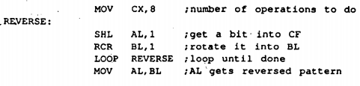
Reversing Bit Pattern Application
Expectation: If AL contains 11011100, we want to make it 00111011
Use SHL to shift the bits out the left end of AL Into CF.
Then use RCR to move them Into the left end of another register (i.e. BL)
Run the above operation 8 times for 8 bits

Slide 29
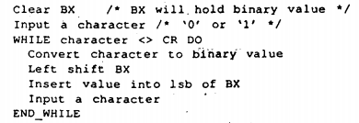
Binary and Hex Input & Output
Binary Input: Lets assume a program reads In a binary number from the keyboard, followed by a carriage return. [i.e. string of 0’s and 1’s]
Conversion in bit value needs to be done as soon as the input character is entered.
After that collect the bits in register.
To read a binary number from keyboard and store it in BX:

Slide 30
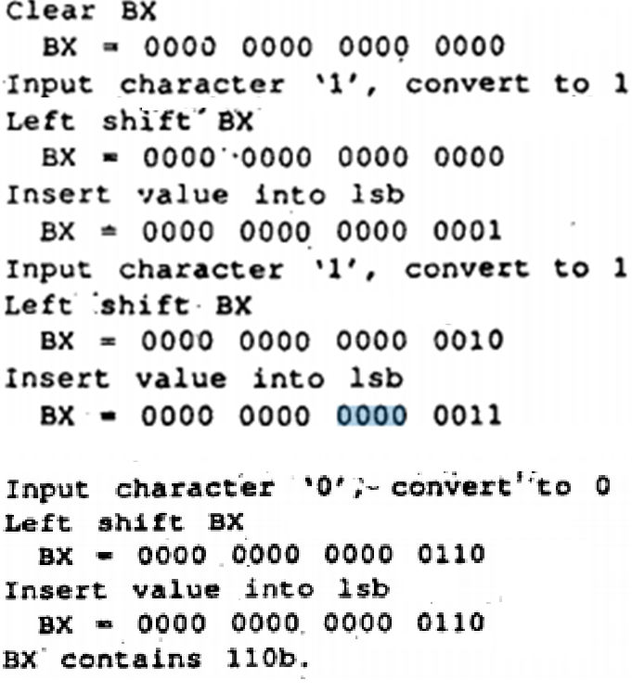
Example: Process Input 110

Slide 31
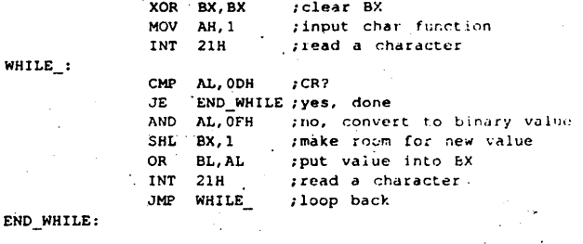
Assembly Conversion for input processing (110)

Slide 32
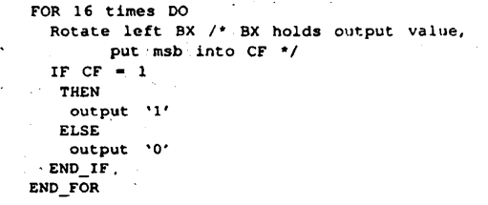
Binary Output
Outputting the contents of BX in binary also involves the shift operation.
Algorithm for Binary output:
Write an assembly code to process the Binary output for this problem.

Slide 33
Hex Input
Hex input consists of digits ("0" to "9") and letters ("A" to "F”) followed by a carriage return.
For simplicity, we will assume that
Only uppercase letters are used, and
The user inputs no more than four hex characters.
The process of converting characters to binary values is more Involved than it was for binary input, and BX must be shifted four times to make room for a hex value.

Slide 34
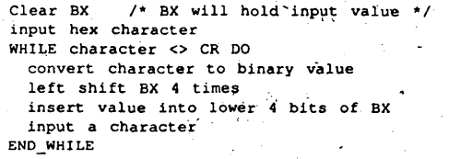
Algorithm for hex input

Slide 35
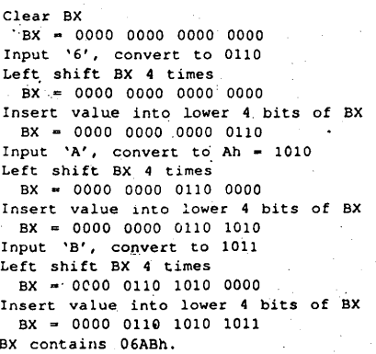
Example: input 6AB

Slide 36
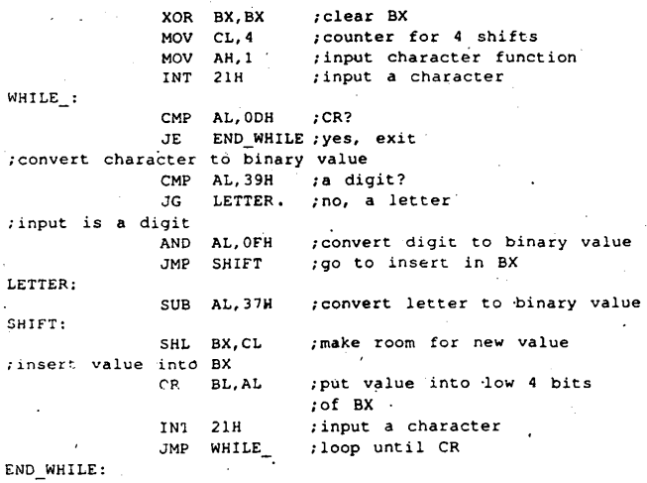
Assembly Code for Processing 6AB

Slide 37
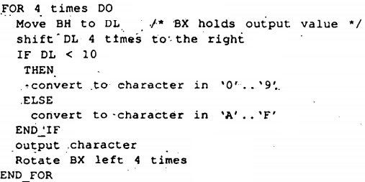
Algorithm for Hex Output

Slide 38
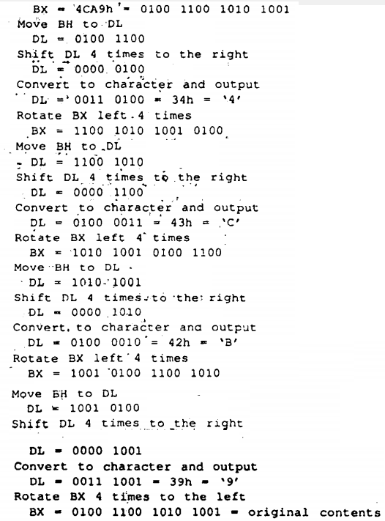
Conversion of 4CA9h to Binary
Write an assembly code to process the Binary output for this problem.

Slide 39
References
Assembly Language Programming and Organization of the IBM PC, Ytha Yu and Charles Marut, McGraw Hill, 1992. (ISBN: 0-07-072692-2).
http://faculty.cs.niu.edu/~byrnes/csci360/notes/360shift.htm

Slide 40
Books
Assembly Language Programming and Organization of the IBM PC, Ytha Yu and Charles Marut, McGraw Hill, 1992. (ISBN: 0-07-072692-2).
Essentials of Computer Organization and Architecture, (Third Edition), Linda Null and Julia Lobur
W. Stallings, “Computer Organization and Architecture: Designing for performance”, 67h Edition, Prentice Hall of India, 2003, ISBN 81 – 203 – 2962 – 7
Computer Organization and Architecture by John P. Haynes.

